Slide 1

Using Advanced MySQL Techniques
Sales Performance Analysis of Walmart Stores
By Ruturaj T. Saravane

Slide 2


INTRODUCTION
Walmart, a leading retail chain, wants to optimize its sales strategies by analyzing historical transaction data.
Objective & Dataset
Primary aim is to utilize MySQL to analyze sales performance, customer behavior, and operational efficiencies across different branches.
We have utilized Walmart's sales transaction data, which includes customer demographics, product lines, sales figures, and payment methods.

Slide 3
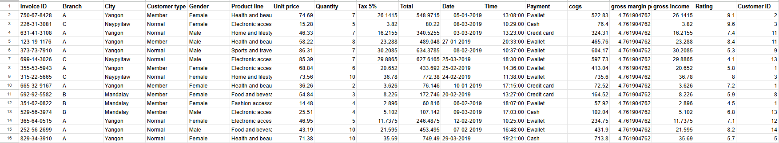
Walmart aims to:
Identify the top-performing branches.
Detect anomalies in sales transactions.
Understand customer segmentation and spending behavior.
Optimize product line profitability.
Determine preferred payment methods and shopping trends.
Key Metrics:
Total 1000 Transactions
Total number of Customers - 15
Three branches with six Product lines
Data period of three months of year 2019.

Slide 4
Data Transformation In SQL
#Creating Database “project” and formatting column with appropriate data types
use project;
alter table walmart
add column new_date date,
add column new_time time;
update walmart
set new_date = str_to_date(`date`, '%d-%m-%Y’),
new_time = str_to_date(`time`, '%H:%i:%s');
alter table walmart
drop column date,
drop column time;
alter table walmart
rename column new_date to date,
rename column new_time to time;
#To remove unwanted space between each column name for ease of access.
alter table walmart
rename column `invoice id` to invoice_id,
rename column `customer type` to cust_type,
rename column `product line` to product_line,
rename column `unit price` to unit_price,
rename column `tax 5%` to tax_5_percent,
rename column `gross margin percentage` to gross_margin_percent,
rename column `gross income` to gross_income,
rename column `customer id` to cust_id;
#To check complete data
Select * from walmart;

Slide 5
Task 1 - Identifying the Top Branch by Sales Growth Rate
Objective : Identify which branch exhibits the highest monthly sales growth
#Total sales per Branch.
select branch, sum(total) as total_sales
from walmart
group by branch
order by total_sales;
#To showcase total sales of Branch distributed monthly.
select branch, month(date) as month_of_sales,
round(sum(total), 2) as 'total sales'
from walmart
group by branch, month_of_sales with rollup;
branch | month_of_sales | total sales
A | 1 | 38681.13
A | 2 | 29860.12
A | 3 | 37659.12
A | Total | 106200.4
B | 1 | 37176.06
B | 2 | 34424.27
B | 3 | 34597.34
B | Total | 106197.7
C | 1 | 40434.68
C | 2 | 32934.98
C | 3 | 37199.04
C | Total | 110568.7
NULL | Total | 322966.8

Slide 6
# Growth Rate Per Month
select branch, months, total_sales,
lag(total_sales,1,0) over(partition by branch order by branch, months) as prev_total,
round((total_sales - lag(total_sales) over(partition by branch order by branch, months))/
lag(total_sales) over(partition by branch order by branch, months) * 100, 2) as growth_rate_percentage
from monthly_sales;
branch | months | total_sales | prev_total | growth_rate_percentage
A | 1 | 38681.13 | 0 | NULL
A | 2 | 29860.12 | 38681.13 | -22.8
A | 3 | 37659.12 | 29860.12 | 26.12
B | 1 | 37176.06 | 0 | NULL
B | 2 | 34424.27 | 37176.06 | -7.4
B | 3 | 34597.34 | 34424.27 | 0.5
C | 1 | 40434.68 | 0 | NULL
C | 2 | 32934.98 | 40434.68 | -18.55
C | 3 | 37199.04 | 32934.98 | 12.95

Slide 7
# Average Growth Rate Per Branch
with growth_rate as
(select branch, months, total_sales,
lag(total_sales,1,0) over(partition by branch order by branch, months) as prev_total,
round((total_sales - lag(total_sales) over(partition by branch order by branch, months))/
lag(total_sales) over(partition by branch order by branch, months) * 100, 2) as growth_rate_percentage
from monthly_sales)
select branch, round(sum(total_sales), 2) as total_sales,
round(avg(growth_rate_percentage), 2) as avg_growth_rate
from growth_rate
group by branch;
branch | total_sales | avg_growth_rate
A | 106200.4 | 1.66
B | 106197.7 | -3.45
C | 110568.7 | -2.8

Slide 8
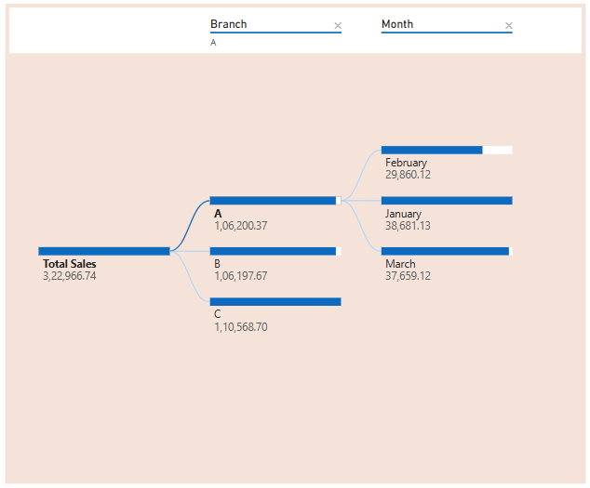
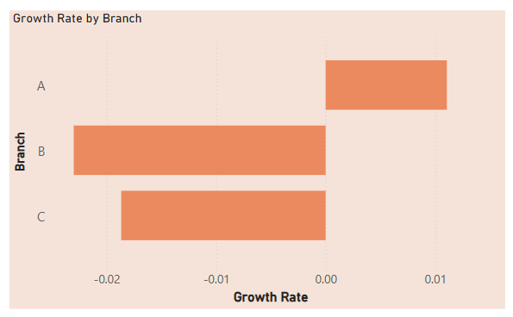

Slide 9
Task 2: Finding the Most Profitable Product Line for Each Branch Objective : Identify the product line that generates the highest profit in each branch.
#Approach 1 (using ranks)
with profitable_product_line as
(select branch, product_line, sum(gross_income - cogs) as highest_profit
from walmart
group by branch, product_line
order by branch, highest_profit desc)
select branch, product_line, highest_profit from
(select branch, product_line, highest_profit,
dense_rank()
over(partition by branch
order by highest_profit desc
) ranks
from profitable_product_line) ranked
where ranks = 1;
#Approach 2 (using join with subquery)
with branch_product_profit as
(select branch, product_line, sum(gross_income - cogs) as highest_profit
from walmart
group by branch, product_line
order by branch, highest_profit desc)
select bp2.branch, bp1.product_line, bp2.highest_profit
from branch_product_profit bp1
join
(select branch, max(highest_profit) as highest_profit
from branch_product_profit
group by branch) as bp2
on bp1.highest_profit = bp2.highest_profit;

Slide 10
#Approach 3 (using join between view & CTE)
create view branch_product_1 as
select branch, product_line, sum(gross_income - cogs) as highest_profit
from walmart
group by branch, product_line
order by branch, highest_profit desc;
with branch_product_2 as
(select branch, max(highest_profit) as highest_profit
from branch_product_profit
group by branch)
select bp2.branch, bp1.product_line, bp2.highest_profit
from branch_product_2 bp2
join branch_product_1 bp1
on bp1.highest_profit = bp2.highest_profit;
All the above approaches provide the following output which is branch wise highest earning product line -
branch | product_line | highest_profit
A | Health and beauty | -11397.97
B | Food and beverages | -13765.86
C | Home and lifestyle | -12572.17

Slide 11
Task 3: Analyzing Customer Segmentation Based on Spending
Objective : Categorize customers into High, Medium, and Low spenders based on their total purchases..
#Approach 1 (Average of combined spending of each customer)
create view pass_total_sales as
(select cust_id, round(sum(cogs), 2) as total_sales
from walmart
group by cust_id);
select avg(total_sales) from pass_total_sales;
select cust_id, total_sales,
case
when total_sales < 19000 then 'Low'
when total_sales > 22000 then 'High'
else 'Medium'
end as Spending_Category
from pass_total_sales;
#Approach 2 (Average of all transactions)
select round(avg(cogs), 2) as avg_cogs
from walmart;
with each_avg as
(select cust_id, round(avg(cogs), 2) as avg_of_each
from walmart
group by cust_id)
select cust_id, avg_of_each,
case
when avg_of_each < 270 then 'Low'
when avg_of_each > 330 then 'High'
else 'Medium'
end as Spending_Cstegory
from each_avg;

Slide 12
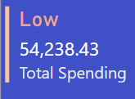
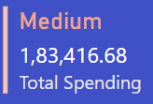
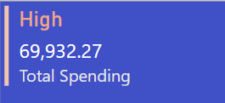
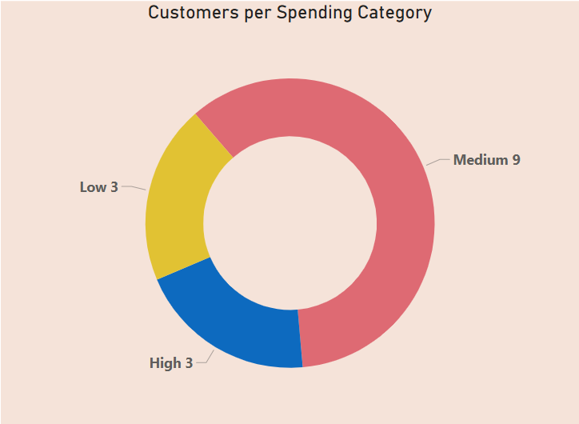
cust_id | total_sales | Spending_Category
1 | 21556.71 | Medium
2 | 22278.36 | High
3 | 22287.87 | High
4 | 16815.92 | Low
5 | 18697.18 | Low
6 | 19708.53 | Medium
7 | 19645.8 | Medium
8 | 25366.04 | High
9 | 18725.33 | Low
10 | 19737.08 | Medium
11 | 20379.83 | Medium
12 | 20686.33 | Medium
13 | 20060.63 | Medium
14 | 20047.05 | Medium
15 | 21594.72 | Medium

Slide 13
Task 4: Detecting Anomalies in Sales Transactions
Objective : Identify unusually high or low sales transactions compared to the average for each product line.
# 5% outliers are considered as anomalies using magnitude of ± 2 standard deviations from average.
with avg_by_pl as
(select product_line, round(avg(total),2) as avg_sales, stddev(total) as std_dev
from walmart
group by product_line)
select w.invoice_id, a.product_line, a.avg_sales, round(w.total, 2) as sales
from walmart w
join avg_by_pl a
on w.product_line = a.product_line
where w.total > (avg_sales + std_dev*2)
or w.total < (avg_sales - std_dev*2)
order by sales desc;
invoice_id | product_line | avg_sales | sales
860-79-0874 | Fashion accessories | 305.09 | 1042.65
687-47-8271 | Fashion accessories | 305.09 | 1039.29
283-26-5248 | Food and beverages | 322.67 | 1034.46
751-41-9720 | Home and lifestyle | 336.64 | 1023.75
303-96-2227 | Home and lifestyle | 336.64 | 1022.49
744-16-7898 | Home and lifestyle | 336.64 | 1022.38
271-88-8734 | Fashion accessories | 305.09 | 1020.7
234-65-2137 | Home and lifestyle | 336.64 | 1003.59
554-42-2417 | Sports and travel | 332.07 | 1002.12
325-77-6186 | Home and lifestyle | 336.64 | 951.82
280-17-4359 | Health and beauty | 323.64 | 950.25
219-22-9386 | Sports and travel | 332.07 | 944.62
702-83-5291 | Fashion accessories | 305.09 | 943.3
731-81-9469 | Sports and travel | 332.07 | 942.9
… | … | … | …
… | … | … | …

Slide 14
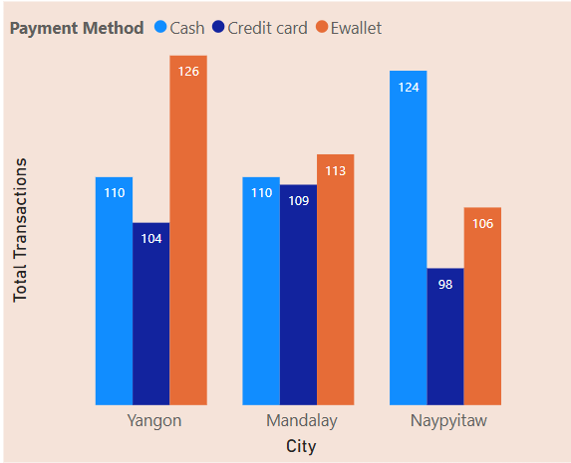
Task 5: Most Popular Payment Method by City
Objective : Determine the most frequently used payment method in each city.
#Popular payment method using Rank
with total_payment as
(select city, payment, count(payment) as payment_count
from walmart
group by city, payment)
select City, payment, Payment_count
from
(select city, payment, payment_count,
rank()
over(
partition by city
order by payment_count desc
) as ranks
from total_payment) tp2
where ranks = 1;
City | payment | Payment_count
Mandalay | Ewallet | 113
Naypyitaw | Cash | 124
Yangon | Ewallet | 126

Slide 15
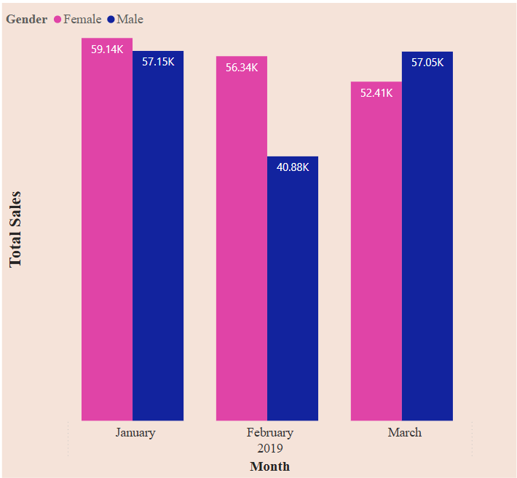
Task 6: Monthly Sales Distribution by Gender
Objective : Analyze sales distribution between male and female customers on a monthly basis.
#Monthly sales distributed as per gender
select month(date) as month, gender,
round(sum(total), 2) total_sales
from walmart
group by month, gender
order by month, gender;
month | gender | total_sales
1 | Female | 59138.98
1 | Male | 57152.89
2 | Female | 56335.56
2 | Male | 40883.82
3 | Female | 52408.39
3 | Male | 57047.12

Slide 16
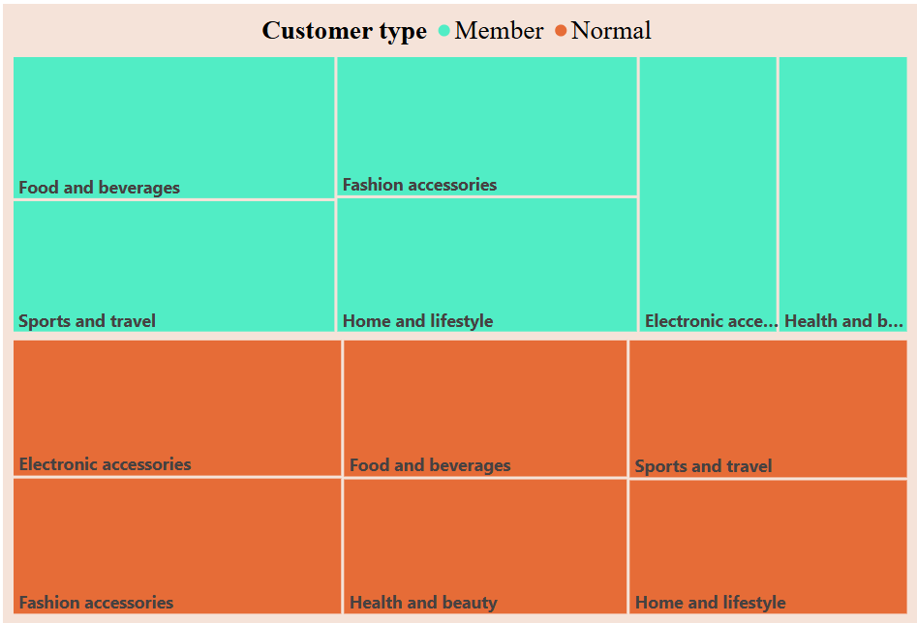
Task 7: Best Product Line by Customer Type
Objective : Identify which product lines are most preferred by Member and Normal customers.
#Best product per customer type in each product line
with pl_of_ct as
(select product_line, cust_type, count(*) as no_of_transc
from walmart
group by product_line, cust_type)
select cust_type, product_line, no_of_transc
from
(select cust_type, product_line, no_of_transc,
rank()
over(
partition by cust_type
order by no_of_transc desc
) ranks
from pl_of_ct) plct
where ranks = 1;
cust_type | product_line | no_of_transc
Member | Food and beverages | 94
Normal | Electronic accessories | 92
Normal | Fashion accessories | 92

Slide 17
Task 8: Identifying Repeat Customers
Objective : Find customers who made multiple purchases within a 30-day time frame.
#Approach 1 (Joining ranked data)
create view date_ranks as
(select cust_id, date, date_add(date, interval 30 day) as intrvl
from (select cust_id, date,
row_number()
over(
partition by cust_id
order by date
) as ranks
from walmart) date_rank
where ranks = 1);
select w.cust_id, count(*) as repeat_purchase_count
from walmart w
join date_ranks d
on w.cust_id = d.cust_id
where w.date <= d.intrvl
group by w.cust_id
order by w.cust_id;
#Approach 2 (Using date add function with join)
with date_interval as
(select cust_id, min(date) first_date,
date_add(min(date), interval 30 day) as intrvl
from walmart
group by cust_id)
select w.cust_id, count(*) as repeat_purchase_count
from walmart w
join date_interval d
on w.cust_id = d.cust_id
where w.date <= intrvl
group by w.cust_id
order by w.cust_id;

Slide 18
#Approach 3 (using view & date diff. function with join)
create view First_Purchase as
(select cust_id, min(date) as first_purchase_date
from walmart
group by cust_id
);
with Repeat_Purchases as
(select w.cust_id, w.date, f.first_purchase_date,
datediff(w.date, f.first_purchase_date) as days_since_first_purchase
from walmart w
join First_Purchase f
on w.cust_id = f.cust_id
)
select cust_id, count(*) as repeat_purchase_count
from Repeat_Purchases
where days_since_first_purchase between 0 and 30
group by cust_id
order by cust_id;
cust_id | repeat_purchase_count
1 | 27
2 | 25
3 | 25
4 | 22
5 | 19
6 | 26
7 | 29
8 | 21
9 | 18
10 | 26
11 | 27
12 | 23
13 | 29
14 | 24
15 | 21

Slide 19
Task 9: Finding Top 5 Customers by Sales Volume
Objective : Identify the top 5 customers who have generated the highest revenue.
#Displaying top 5 customers using limit function.
select cust_id, round(sum(total), 2) as total_sales
from walmart
group by cust_id
order by total_sales desc
limit 5;
ranks | cust_id | total_sales
1 | 8 | 26634.34
2 | 3 | 23402.26
3 | 2 | 23392.28
4 | 15 | 22674.46
5 | 1 | 22634.55
#Using rank function to show top 5 customers
select rank()
over(order by sum(total) desc) as ranks,
cust_id, round(sum(total), 2) as total_sales
from walmart
group by cust_id
limit 5;

Slide 20
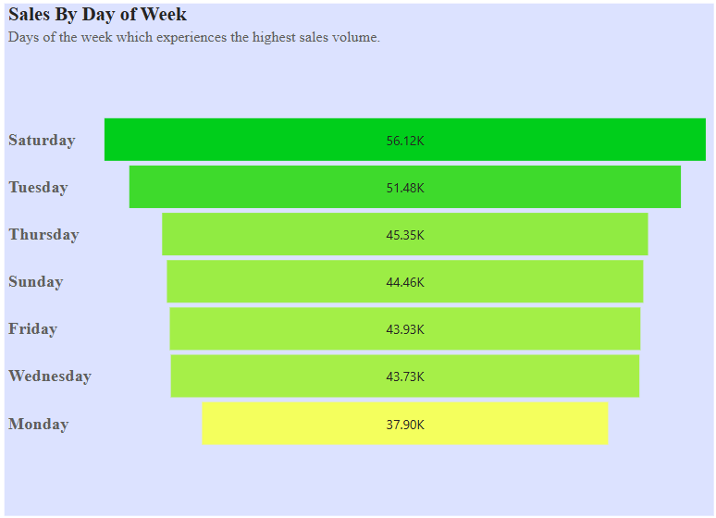
Task 10: Analyzing Sales Trends by Day of the Week
Objective : Determine which day of the week experiences the highest sales volume.
#Using dayname function to extract day of the week
select dayname(date) as week_day,
round(sum(total), 2) as total_sales
from walmart
group by week_day
order by total_sales desc;
week_day | total_sales
Saturday | 56120.81
Tuesday | 51482.25
Thursday | 45349.25
Sunday | 44457.89
Friday | 43926.34
Wednesday | 43731.14
Monday | 37899.08

Slide 21

Key findings and Insights
Top-Performing Branch:
The branch C is showing the highest total sales however observing the average sales growth rates, branch A had the positive trend.
Branch C and A can be considered as the strong performers for potential expansion.
Most Profitable Product Lines:
Health and beauty, food and beverages and home and lifestyle these are the top-earning product lines for the three branches that is A, B and C respectively.
These product lines consistently generated higher profits across all branches, suggesting high demand.
Customer Segmentation:
Based on spending behaviour, most of the customers fall under medium spending category. High and Low spenders are equal in numbers though their spending behaviour is also similar.
High-spending customers tend to buy specific product categories, which can be leveraged for targeted promotions.
Sales Trends by Payment Method:
Customers from Mandalay city preferred to use Ewallet as their payment mode more frequently and the same applies to Yangon city too. Cash payment method is more likely to be seen in Naypyitaw city.
This indicates a preference that could influence future marketing strategies.
Monthly Sales Distribution:
Month of January showed highest sales than rest. Except March month where the total sales by female customers is slightly less than male customers, the female customers tend to spend more than male customers.
Sales showed this fluctuations, which can be used for better inventory and discount planning.

Slide 22




R C O M M E N D A T I O N S
To Boost High-Growth Branches we can invest in customers incentives for top branches and use of predictive analysis to ensure high selling items remains available.
It would be better to expand high-performing product lines with increased inventory and promotions and to reduce focus on underperforming products.
We could implement a Loyalty programs strategy for high-spending customers to encourage repeat purchases, special discounts or bundled deals for low and medium spenders to increase their spending levels.
To optimize payment method, we can encourage the use of preferred payment methods with cashback offers.

Slide 23

Thank you
Ruturaj T. Saravane

